Slide 1
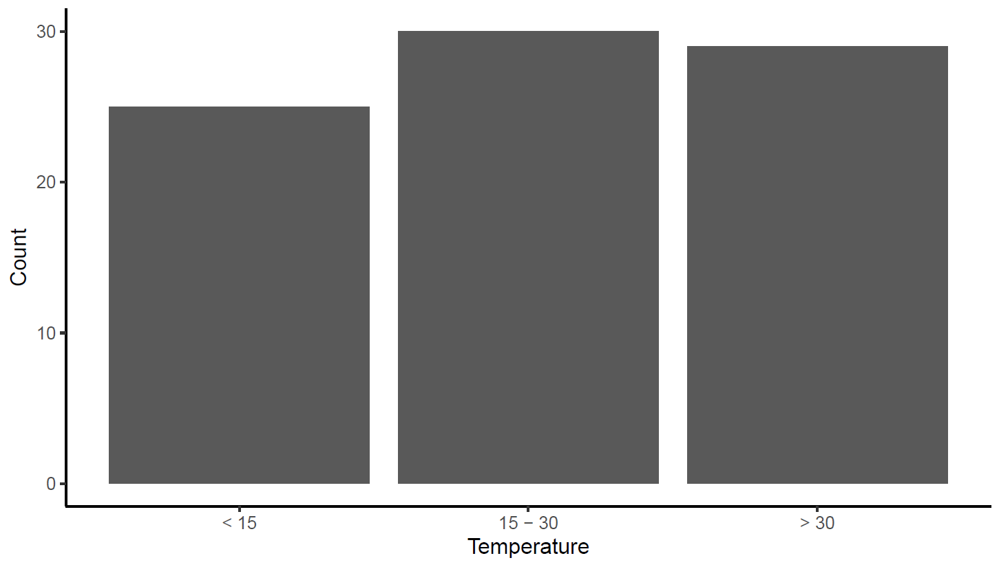
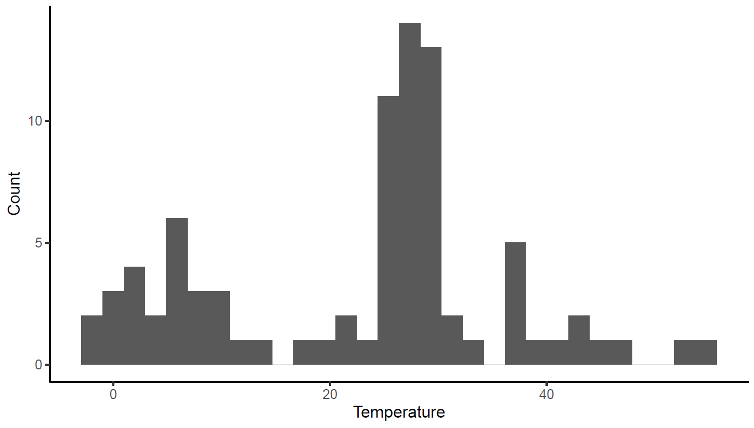
OleA temperatures
Review of the dataset:
123 OleAs from organisms with diverse optimal growth temperatures

Slide 2
Machine learning with OleA temperature preference
Goal: Identify sequence signatures of OleA temperature preference
Dataset: combination of 30 TARA sequences, 73 OleAs from previous studies, and 20 interesting psychrophiles and thermophiles
Prediction: optimal growth temperatures (from literature)
Predictors: OleA sequence features (previously whole-protein stats)

Slide 3
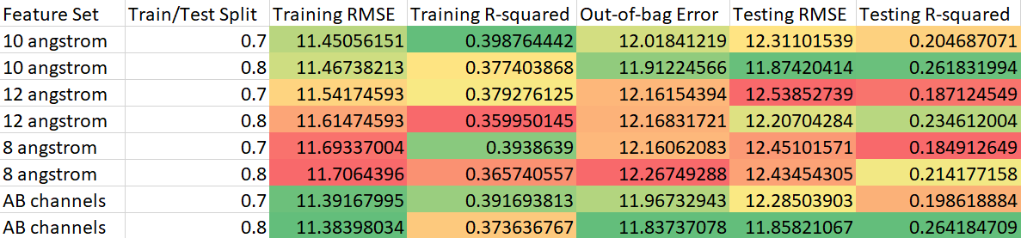
Regression
Which feature set gives the best prediction?

Slide 4
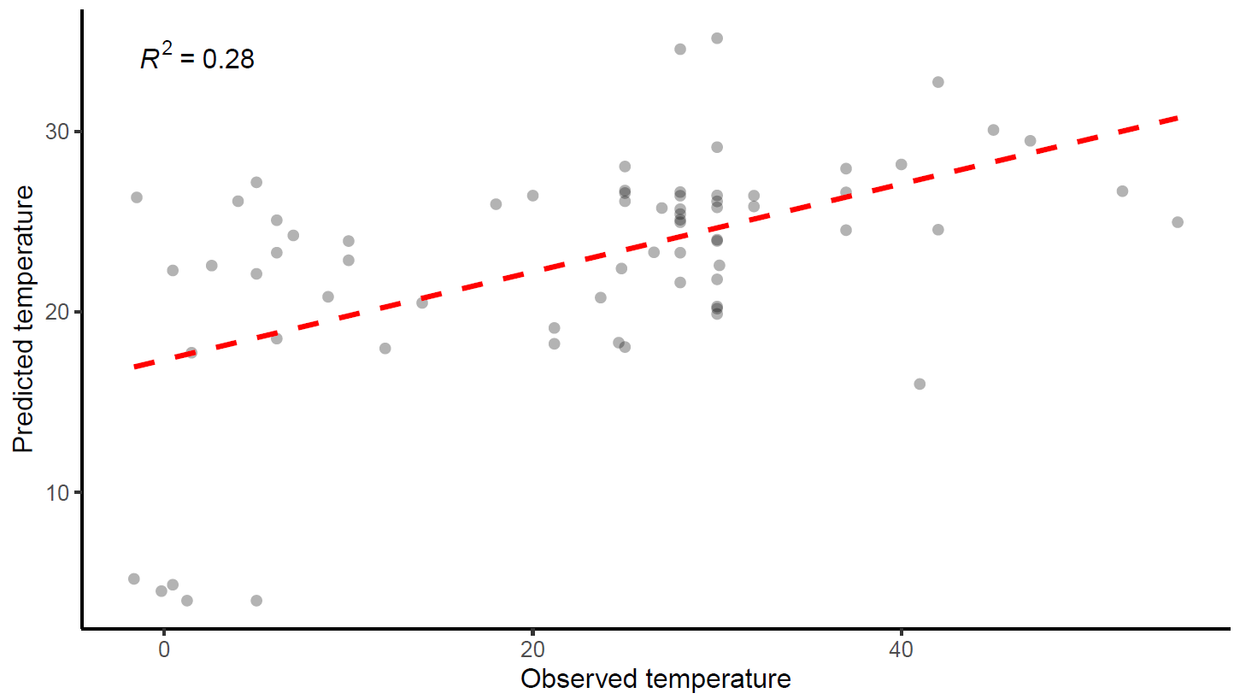
Example prediction plot

Slide 5
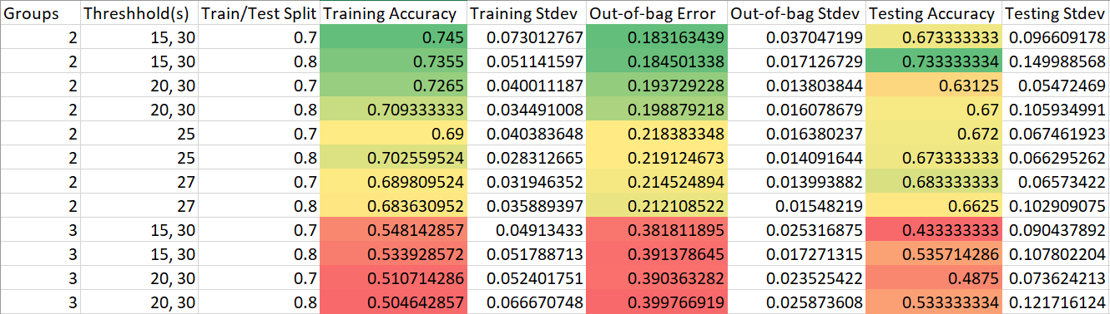
Categorical
Which threshold gives the best prediction?
*

Slide 6
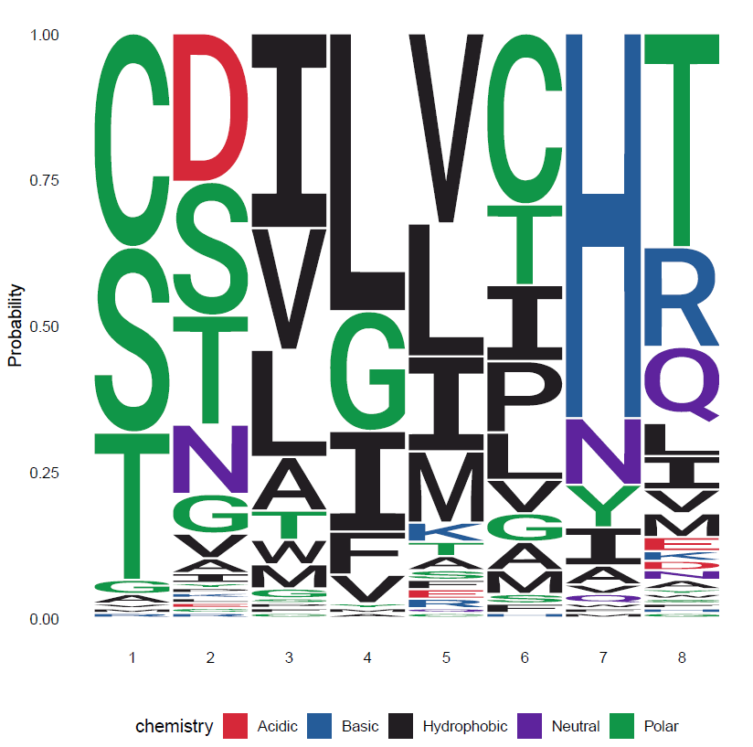
Which residues?
In Xanthomonas campestris:
112S
172T
176V
203L
258I
284I
291H
292T

Slide 7
Next steps
Possibly use mutant library for experiments
Test thermostability/activity at various temperatures
What else?
Unsaturated preference

